Slide 1
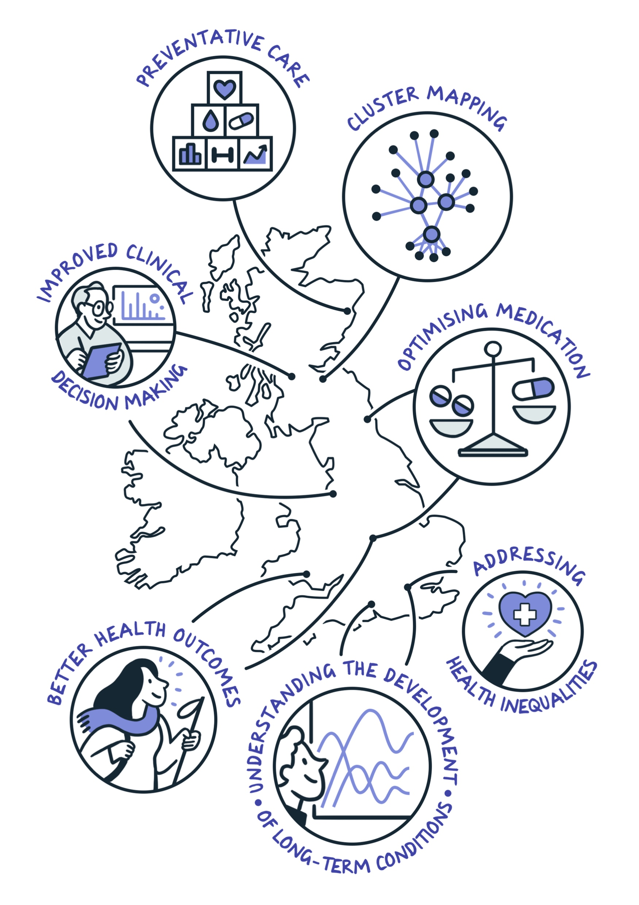

Introduction to Grant Writing
Emma Karoune, Emmy Bocaege and Jacqueline Aldridge
CC-BY 4.0
DOI: https://doi.org/10.5281/zenodo.12583402

Slide 2

Workshop schedule
10:00 - 10:30 - Introduction to funding landscape for health and medical science research grants and fellowships - Emmy Bocaege
10:30 - 10:35 - Q & A
10:35 - 10:45 - My career in grants and fellowships - Emma Karoune
10:45 - 11:45 - Introduction to grant writing - Jacqueline Aldridge
11:45 - 12:00 - Break
12:00 - 13:00 - Writing process and abstract editing

Slide 3
Funding landscape
Emmy Bocaege
Turing research development manager

Slide 4




OVERVIEW
Why
Funding models
Who funds what?
Your research funding plan
Image was created by Scriberia for AI for multiple long-term conditions: Research Support Facility (AIM RSF) and is used under a CC-BY licence https://doi.org/10.5281/zenodo.7739071

Slide 5

YOUR MOTIVATION?
Developing your research profile
Impact (academic, conceptual, instrumental, capacity building)
Image was created by Scriberia for AI for multiple long-term conditions: Research Support Facility (AIM RSF) and is used under a CC-BY licence https://doi.org/10.5281/zenodo.7739071

Slide 6
FUNDING MODELS
Responsive mode versus Challenge led
Solo vs Team
Image was created by Scriberia for AI for multiple long-term conditions: Research Support Facility (AIM RSF) and is used under a CC-BY licence https://doi.org/10.5281/zenodo.7739071

Slide 7
Usual suspects: who funds what?
Public Bodies
Department for Science Innovation and Technology: UKRI/ARIA
Department of Health and Social Care: NIHR
Learned Societies
Royal Society
British Academy
Royal Society of Medicine
Charities
Wellcome
Cancer Research UK
British Heart Foundation Leverhulme Trust
International
European Commission:
- ERC
- MSCA
- Horizon Europe

Slide 8

PUBLIC BODIES: UKRI
5 Year strategy (2022-2027):
build a green future
build a secure and resilient world
create opportunities and improve outcomes in communities across the country
secure better health, ageing and wellbeing for everyone
tackle infections
Image was created by Scriberia for AI for multiple long-term conditions: Research Support Facility (AIM RSF) and is used under a CC-BY licence https://doi.org/10.5281/zenodo.7739071

Slide 9
UKRI Research Councils
Arts and Humanities Research Council AHRC
Biotechnology and Biological Sciences Research Council BBSRC
Engineering and Physical Sciences Research Council EPSRC
Economic and Social Research Council ESRC
Innovate UK
Medical Research Council MRC
Natural Environment Research Council NERC
Research England
Science and Technology Facilities Council STF
Image was created by Scriberia for AI for multiple long-term conditions: Research Support Facility (AIM RSF) and is used under a CC-BY licence https://doi.org/10.5281/zenodo.7739071

Slide 10

PUBLIC BODIES: NIHR
‘Innovation pathway’: early ‘translational’ -> clinical -> applied
strategic focus:
Build on learnings from COVID-19 research response and support recovery of health/social care system
Build capacity/capability in preventative, public health and social care research
Improve lives of people with multiple long-term conditions through research
Bring clinical/applied research to under-served regions/communities with major health needs
Embed EDI across NIHR's research, systems and culture
Strengthen research delivery staff careers/underrepresented disciplines/specialisms
Work with life sciences industry to improve health/economic prosperity
Image was created by Scriberia for AI for multiple long-term conditions: Research Support Facility (AIM RSF) and is used under a CC-BY licence https://doi.org/10.5281/zenodo.7739071
Notes:
‘translational’ research (translating discoveries from the laboratory to the clinic)

Slide 11
PUBLIC BODIES: NIHR
Funding programmes (multiple calls/year; researcher-led and commissioned)
Research training (fellowships, professorships, integrated academic training, incubators, career recognition awards etc) and NIHR academy
Themed calls (Compound pressure)/Highlight Notices (Brain tumours, Motor neurone disease and dementia)
NIHR research support service can help with:
- identifying funding sources
- research design
- research methods
- involving patients and the public
NIHR local clinical research networks can support with projects that involve patients and staff at NHS trusts (AcoRD guidance and SoECAT completion)
Image was created by Scriberia for AI for multiple long-term conditions: Research Support Facility (AIM RSF) and is used under a CC-BY licence https://doi.org/10.5281/zenodo.7739071
Notes:
NIHR themed calls are funding opportunities focusing on a particular priority research area. The government’s Chief Medical Officer sets out an annual research priority, calling for researchers with interest in that area, to come forward. We advertise themed funding opportunities across many of our UK programmes. When assessing funding applications, we prioritise those submitted in response to a themed call.

Slide 12
CHARITIES: WELLCOME
Challenge areas (impact awards, commissioned research, challenge-led funding):
Mental health
Climate and health
Infectious disease
Discovery research funding (early career, career development, discovery awards):
fundamental processes that underpin biology
complexities of human health and disease (clinical/population-based)
burden of disease and its determinants
development methodologies, conceptual frameworks, technologies, tools, techniques
needs, values, priorities of people/communities affected by disease/health disparities
social, ethical, cultural, political, economic, historical contexts of human health/disease.
Image was created by Scriberia for AI for multiple long-term conditions: Research Support Facility (AIM RSF) and is used under a CC-BY licence https://doi.org/10.5281/zenodo.7739071

Slide 13
LEARNED SOCIETIES
National bodies offering fellowships, informing debate, ensuring international engagement
British Academy
- Humanities and Social Sciences
- Strategy 2022-2027
Royal Society
- Computer Science, Mathematics, Physics, Chemistry, Engineering, Earth Sciences, Biology, Neurosciences, Anatomy, Physiology, Evolutionary/Ecological science, Health and Human Sciences
- Strategy 2022-2027
Also: Associations and Societies within your (sub)field often offer small grants for pilot projects
Image was created by Scriberia for AI for multiple long-term conditions: Research Support Facility (AIM RSF) and is used under a CC-BY licence https://doi.org/10.5281/zenodo.7739071

Slide 14
INTERNATIONAL
Horizon Europe: EU’s key R&I funding programme
Mission areas:
- Adaptation to climate change
- Cancer
- Healthy oceans, seas, coastal and inland waters
- Climate-neutral and smart cities
- Soil health and food
3 Pillars:
- Excellent Science, Global Challenges, Innovative Europe
OSCARS
Training (doctoral/postdoctoral): Marie Sklodowska-Curie actions:
-
Image was created by Scriberia for AI for multiple long-term conditions: Research Support Facility (AIM RSF) and is used under a CC-BY licence https://doi.org/10.5281/zenodo.7739071

Slide 15
July 2024
11th NIHR – Advanced fellowship
Open Fellowship Calls : Apply Any Time
UKRI: EPSRC postdoctoral fellowships-responsive-mode, EPSRC open fellowships-responsive-mode, EPSRC open plus fellowships-responsive-mode, EPSRC new investigator award-responsive-mode, ESRC new investigator grants, ESRC secondary data analysis, Daphne Jackson Fellowships
September 2024
10th Royal Society - University Research Fellowship
11th MRC – Career development award
11th MSCA – Postdoctoral fellowships
17th MRC – Population and systems new investigator
July
Aug
June
Sep
Fellowships
Wheel
2024-2025
May
Oct
October 2024
1st Wellcome – Early career awards
TBC NIHR – Advanced Fellowships
2nd BA – Postdoctoral Fellowships
11th (forecast) BA - Innovation fellowships
29nd (forecast) Royal Society - Dorothy Hodgkin fellowships
April 2025
30th (forecast) ESRC - adr uk research fellowships
Apr
Nov
Mar
Dec
Feb
Jan
February 2025
TBC – Leverhulme – Early Career fellowships
November 2024
7th (forecast) ERC – Starting Grant
TBC MRC – Better methods/research new investigator
Adapted from University of Kent research funding wheel
Notes:
Solo or team applications (Fellowship wheel) + networking/connections to be Co-I (new terms in UKRI research teams)

Slide 16

Funding plan
5 year plan
Research Vision: what defines, what do you wish to be known for and why?
Research Aims (key research questions)
Research profile (outputs, impact, funding)
Priorities (unfinished projects/publications)
Support (training, network of collaborators, mentors)
Funding plans for coming year
New bids
Current/forthcoming projects
Development of work/relationships towards new projects/forthcoming funding opportunities
Work in progress (Outputs, Funding, Impact, Research Environment contributions)
Notes:
UoA_Arts_Individual_Research_Plan_Template_12.02.18.pdf

Slide 17

Opportunities
UK Research Council funding finder (Opportunities – UKRI)
EU funding portal
Learned societies/charities websites: British Academy, Royal Society, Royal Society of Medicine, Wellcome
Research Professional
Your research office
Image was created by Scriberia for AI for multiple long-term conditions: Research Support Facility (AIM RSF) and is used under a CC-BY licence https://doi.org/10.5281/zenodo.7739071

Slide 18

Other resources
- Health funding landscape: UK Health Research Analysis Report 2022 (hrcsonline.net)
- The Research Funding Toolkit (Jacqueline Aldridge/Andrew Derrington)
- Phil Ward’s blog http://fundermental.blogspot.co.uk/:
Gateway to Research
- Open Grants website: https://www.ogrants.org/#
- UKRI Research council website (How to apply for research and innovation funding – UKRI)
Image was created by Scriberia for AI for multiple long-term conditions: Research Support Facility (AIM RSF) and is used under a CC-BY licence https://doi.org/10.5281/zenodo.7739071

Slide 19
Researchers' perspective
Dr Emma Karoune

Slide 20
My career in grants and fellowships – Dr Emma Karoune
Successful
SSI Fellowship
ELIXIR-UK Fellowship
IOA - Small fieldwork grants
Skill Policy award – 65K
Wenner Gren fieldwork grants
AEA £500
EOSC-Life open research call – 90K
EOSC-Life training open call – 30K
People in Data – EPSRC 1.7M
Botanical Society - £2500
AHRC Masters studentship
AHRC
PhD studentship
Career break
Internal Turing funding pots
EPSRC grant – 100K
2001
2002
2006
2011
2017
2019
2020
2021
2022
2023
2024
Career break
Philanthropic donor project - 3M
MRC skills 500K
In progress/no result
OSCARS 250K
ICOPS 2 250K
Internal Turing funding pots
EPSRC - wastewater
EPSRC – medicines hub
AHRC
Research project
Postdoc fellowships
Wellcome
Royal Society
Rejected
Daphne Jackson
Dorothy Hodgkins
ARC arch data 3M
Data empowerment fund – 100K
NERC
Research project
BES 50K

Slide 21
Your first research funding bid
planning, writing and winning
29/6/24
Dr. Jacqueline Aldridge

Slide 22

About me
Nearly 20 years research funding support e.g. UKRI, European Research Council, Leverhulme Trust
Lead author of ‘The Research Funding Toolkit’ (Sage, 2012)
Extensive experience supporting early career academics e.g.
UKRI Future Leader Fellowships
ERC Starting Grants
ESRC New Investigator
https://www.linkedin.com/in/jacqueline-aldridge-11b9312b3/
https://jacquelinealdridge.com/

Slide 23

Overview of this WORKSHOP
Creating a ‘fundable’ research project
Planning your application
Writing the proposal

Slide 24
PUBLICATION SUCCESS VS. FUNDING SUCCESS
Publications
Funding bids
Findings of a research project
Disseminates knowledge
Many available journals
Publications are often specialist to discipline
Assessed on its own terms
Low-cost decision for publisher (they don’t pay you)
Revise and resubmit is an option
Plan for a research project
Describes the research process
Few funding sources
Funding agencies are always more generalist
Assessed in competition
High cost and high risk for funder (they pay…and in advance)
Resubmissions are often prohibited

Slide 25
PART 1
CREATING A FUNDABLE RESEARCH PROJECT

Slide 26
WHY DO ORGANISATIONs FUND RESEARCH?
To generate important knowledge (according to their own definition of importance)
This can include capacity building, a regional focus, addressing a specific health challenge, developing a set of tools and methods or supporting a particular type of researcher
To meet their own charitable, political, economic, societal or cultural aims

Slide 27
WHY should a FUNDING AGENCY INVEST In YOU?
Your talent and potential as a researcher
Your capacity to solve an important problem
Methodological or technical expertise
Your capacity or potential to complete a project successfully and within budget
Your knowledge of a particular health condition

Slide 28
Your FUNDABILITY ‘AUDIT’
What currency can you offer a funding agency or collaboration?
1. Specialist methods and techniques
2. Knowledge of specific health conditions
3. Access to particular resources or facilities
4. Links with non-HEI project partners
5. Aspects of project management
To be developed further in the next workshop!

Slide 29
HOW TO FIND OUT ABOUT SPECIFIC FUNDING PRIORITIES
Official guidance can be complex and confusing
…especially the case with the UKRI and government-sponsored schemes
It can be difficult to succeed by just reading the guidance
Criteria vary widely for different funders and schemes

Slide 30

UNDERSTANDING which PROJECTS GET FUNDED
1. Read eligibility and assessment criteria
2. Be prepared for misleading criteria
3. Don’t ignore the assumed or unspoken criteria
4. Check what has already been funded
5. Understand the review process
6. Ask insiders

Slide 31
Official ELIGIBILITY AND ASSESSMENT criteria
Funding scheme web page
Funding agency website
‘More information’ section
Scheme guidance for applicants
Webinars
Strategic priority documents

Slide 32
LOOK OUT FOR MISLEADING CRITERIA
‘We welcome’ or ‘we encourage’
‘As an exception, …’
‘Applicants may be eligible…’
‘We sometimes support…’
Any eligible costs that cannot easily be incorporated or justified

Slide 33
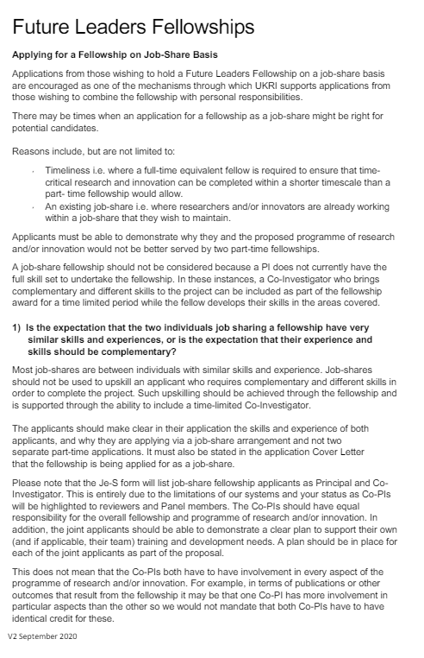
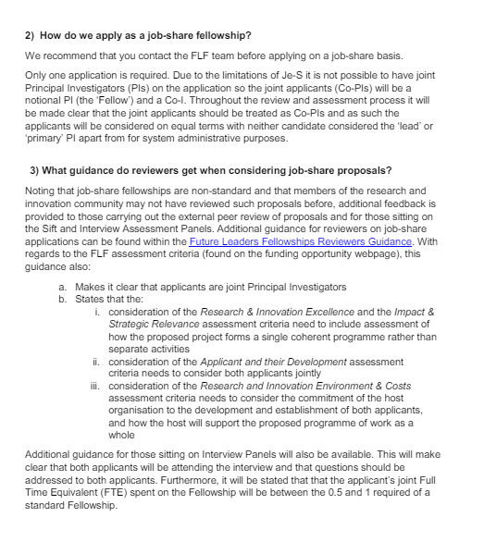
FUTURE LEADERSHIP FELLOWSHIPS: JOB SHARE
https://www.ukri.org/wp-content/uploads/2020/11/UKRI-10112020-FLF-FAQ-on-Job-Shares-R6-FINAL.pdf

Slide 34
IDENTIFYING HIDDEN CRITERIA
Funders may not state the obvious in their scheme criteria e.g.
You usually need a PhD, an academic job and some publications (but this varies).
You can’t already know the answer to your research question.
The project needs to be coherent and logical.
Your topic needs to be of interest outside your discipline.

Slide 35
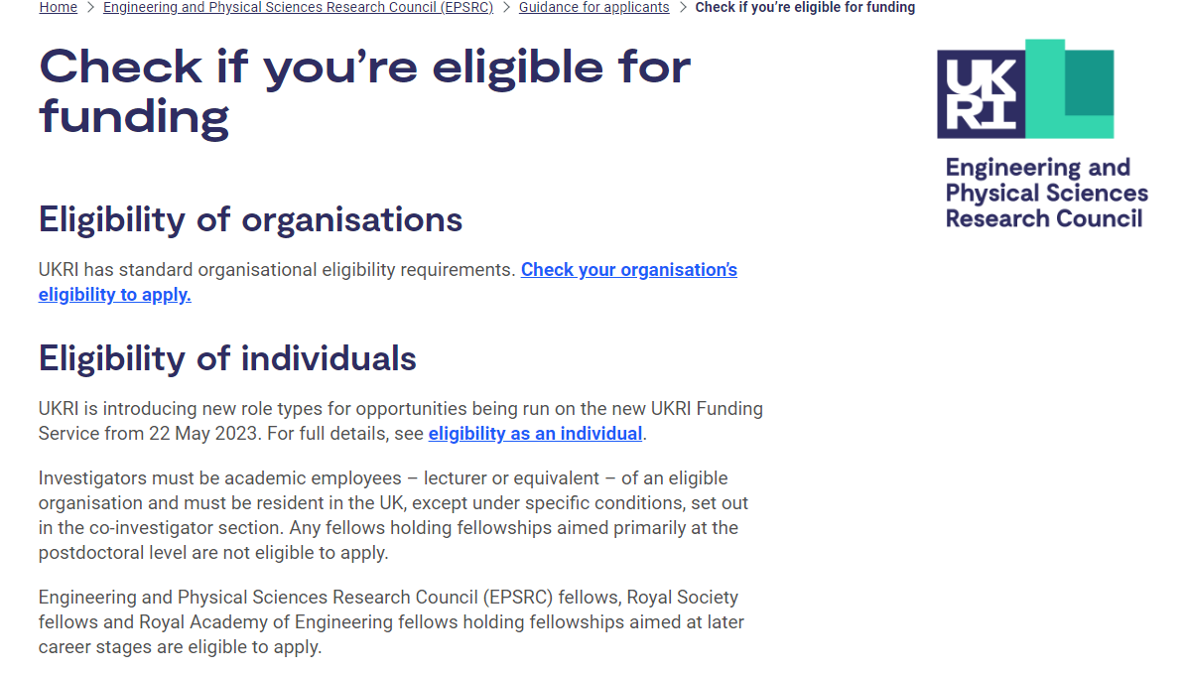
‘HIDDEN’ CRiterion EXAMPLE
https://www.ukri.org/councils/epsrc/guidance-for-applicants/check-if-you-are-eligible-for-funding/

Slide 36
NAVIGATING YOUR WAY THROUGH
What has the agency funded previously?
Guidance for reviewers and review templates
Membership of assessments panel and panel chair
Advice and informal review from those who understand the system
Understanding the review and selection process

Slide 37

PREVIOUSLY FUNDED PROJECTS
GtR (ukri.org)

Slide 38
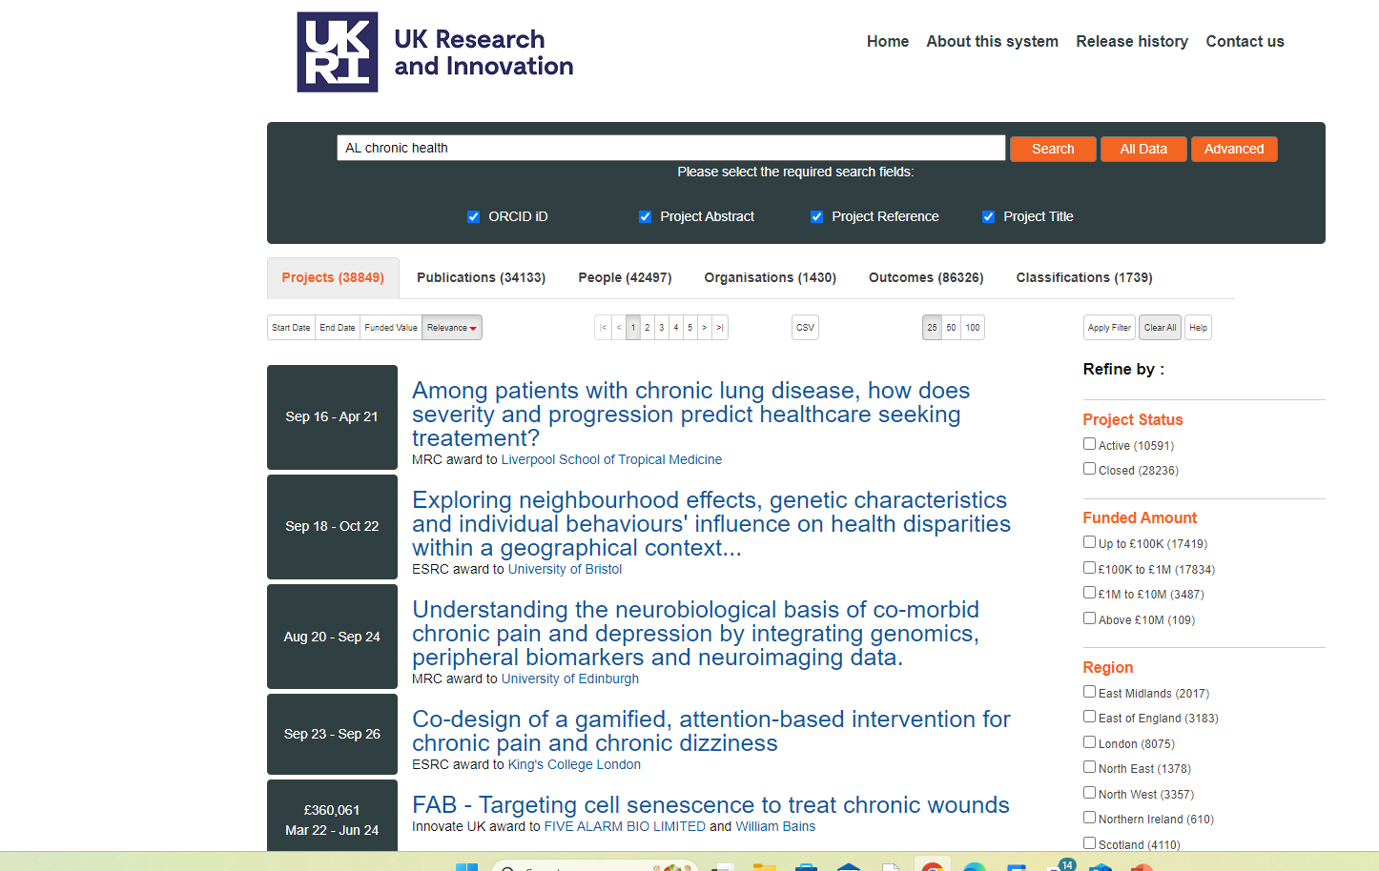
“AI CHRONIC HEALTH” SEARCH

Slide 39
UNDERSTANDING THE ASSESSMENT PROCESS
Administrative secretariat – eligibility checks but perhaps also assigning reviewers
Reviewers – varying levels of expertise, enthusiasm and positivity inform a ‘specialist’ assessment against the evaluation criteria
Panel introducers – less specialist, working under pressure, assigned several bids, diverse and high-quality applications, don’t want to look foolish
Panel members – non-specialist, large numbers of bids to process, need to ask intelligent questions and help rank all bids under consideration

Slide 40
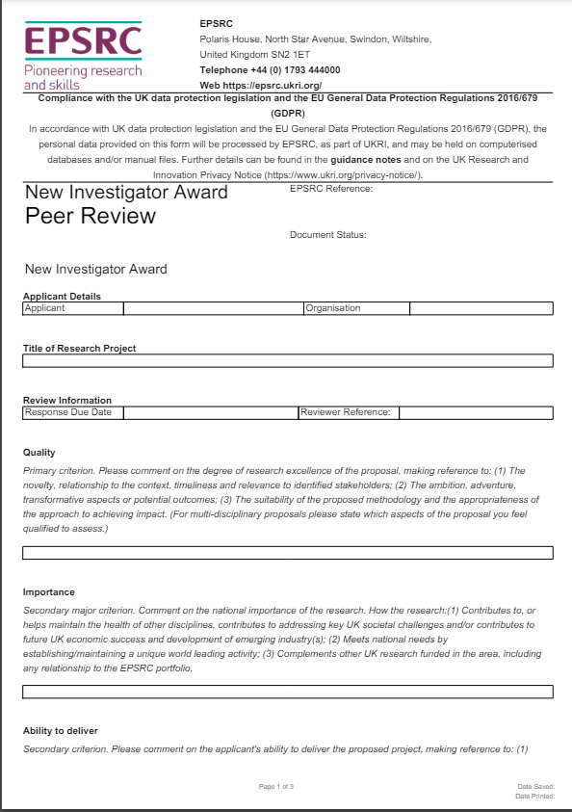
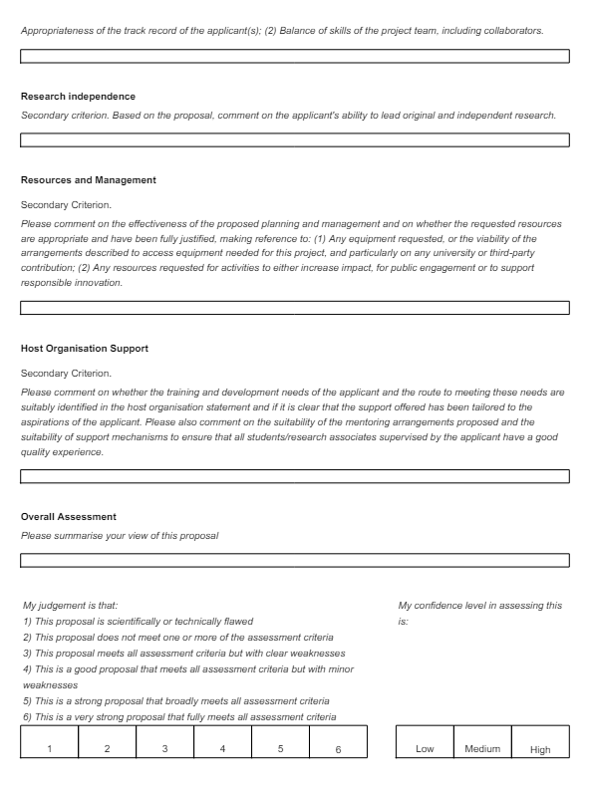
AN EPSRC REVIEW TEMPLATE
https://www.ukri.org/wp-content/uploads/2022/02/EPSRC-10022022-NewInvestigatorAwardPeerReviewForm.pdf

Slide 41
THE ROLE OF LUCK
Peer review may not be specialist, expert, considered or friendly
You cannot predict the competition in any round or panel member preferences
The process is subjective – panel members may advocate their preferred projects
One very brilliant (and expensive) project may consume the available funds

Slide 42
DEVELOPING A ‘FUNdable’ MINDSET
Funding bids are a research input not a research output
Writing funding bids is a sales and marketing job
Some good ideas may not fit an available funding scheme
Applications are technical documents with one purpose – to win a grant
Grants are big, speculative investments: close scrutiny of your ideas is guaranteed

Slide 43
THE
UNDERLYING CRITERIA
OF ALL
FUNDING
SCHEMES
Important and relevant questions
High chance of successful delivery
Excellent value investments
Competent research teams

Slide 44
HOW TO HELP YOUR ASSESSORS DO THEIR JOB
Make your application quick to read
Make your application easy to understand
Make your proposal convincing

Slide 45
PART 2
PLANNING YOUR APPLICATION

Slide 46
EligibLE vs FundabLE VS FUNDED
Most applications will be eligible
But success rates may be 10% or lower
Are your projects ‘worthy of funding’ but rejected?
Do your applications go to the panel/stage 2?

Slide 47
CREATE YOUR FUNDING STRATEGY
Develop a range of project ideas for different funders
Create efficiencies of scale and effort (you speed up with experience)
Take a long-term view of the process to manage (the inevitable) rejection
Check out deadlines, decision times and start dates before you begin

Slide 48
MAIN COMPONENTS OF EVERY PROPOSAL
The question or problem
The research team
The methodology
Feasibility, risk and management
Outcomes and outputs
The budget

Slide 49
THE TYPICAL UKRI APPLICATION
6pp/3000 wordcount (but this varies…always check)
‘Vision’ section
‘Approach’ section
Capability to deliver: R4RI
Budget and Justification of Resources
Summary (abstract)

Slide 50
THE BUREAUCRATIC SECTIONS
Ethics and research integrity
Project management
Timetable/GANTT chart
Beneficiaries and public engagement
These sections can all be deal-breakers
Risk management
EDI action plan

Slide 51
THE BORING BUT IMPORTANT RULES
Word count and page length - 2 to 14
Font and type size
Line spacing
Margin size
References
Figures and tables

Slide 52
A TIMELINE TO SUBMISSION
1. Read the criteria and figure out what the funder wants to invest in.
2. Design the project and scope budget.
3. Scope your overall argument and structure/sub-headings (against the evaluation criteria and required content).
4. Make a list of the evidence you need to include under each sub-heading.
5. Create a full draft – starting with the methods section.
6. Write the first line, abstract and finalise the title.
7. Leave lots of time for feedback and multiple drafts.

Slide 53
PART 3
WRITING YOUR PROPOSAL

Slide 54
FIVE KEY THINGS TO KEEP IN MIND
1. Assume assessors are busy, non-expert and unenthusiastic.
2 Evidence every claim you make in the proposal.
3. See the wood for the trees - remember the four underlying criteria.
5. Rejection of good projects is inevitable – keep on applying.
4. You can’t do this alone – you need professional and academic help.

Slide 55
WHICH PARTS OF THE BID DO ASSESSORS FOCUS ON?
Reviewers
Title and abstract
Budget
Team members
Approach
Other sections as needed for further detail
Panel members
Title and abstract
Budget
Team members
Vision
Reviews
Wider panel may just look at abstract/vision, team and budget

Slide 56
VISION (EPSRC)
is of excellent quality and importance within or beyond the field(s) or area(s)
has the potential to advance current understanding, generates new knowledge, thinking or discovery within or beyond the field or area
is timely given current trends, context and needs
impacts world-leading research, society, the economy or the environment
identifies the potential direct or indirect benefits and beneficiaries

Slide 57
VISION & ‘IMPORTANCE’
is of excellent quality and importance within or beyond the field(s) or area(s)
has the potential to advance current understanding, generates new knowledge, thinking or discovery within or beyond the field or area
is timely given current trends, context and needs
impacts world-leading research, society, the economy or the environment
identifies the potential direct or indirect benefits and beneficiaries

Slide 58
APPROACH (EPSRC)
is effective and appropriate to achieve your objectives
is feasible, and comprehensively identifies any risks to delivery and how they will be managed
uses a clear and transparent methodology
summarises the previous work and describes how this will be built upon and progressed
will maximise translation of outputs into outcomes and impacts
describes how your, and if applicable your team’s, research environment will contribute to the success of the work

Slide 59
APPROACH & ‘SUCCESS’
is effective and appropriate to achieve your objectives
is feasible, and comprehensively identifies any risks to delivery and how they will be managed
uses a clear and transparent methodology
summarises the previous work and describes how this will be built upon and progressed
will maximise translation of outputs into outcomes and impacts
describes how your, and if applicable your team’s, research environment will contribute to the success of the work

Slide 60
HOW TO EVIDENCE COMPETENCE
Capability to Deliver (R4RI)
Team composition
Your choice of scheme
Self-citation
Justification of methods
Professionally presented proposal

Slide 61
HOW TO EVIDENCE VALUE
Budget and Justification
Conferences in the Seychelles?
Importance of topic vs price of project
Economical methods (e.g. secondary data)

Slide 62
CONVINCE YOUR ASSESSORS: VISION
Quality & Importance
Why do we need to know the answer to your question?
Why hasn’t the question been asked before…or answered properly?
What makes you and your team uniquely placed to answer it?
Knowledge
What will the project tell us that we didn’t already know?
How will the findings and/or methodological development contribute to your field?
How will your findings interest those outside your sub-discipline or academia?
‘A gap in the literature’ is not evidence or originality or contribution
Impact & Timeliness
Why now (i.e. the start date in 18 months!) is the best time to answer your question?
Benefits & Beneficiaries
Who will use your findings?
In what ways will they find them useful?
How is your approach of the highest quality?
What will your project change in the world?
As with impact, what will your project change in the world?

Slide 63
CONVINCE YOUR ASSESSORS: APPROACH
Context
Selected, relevant research and evidence from a range of fields – not a full literature review of your field or sub-field
Demonstrate with evidence why the question needs answering now or needs a new answer
Design and methods
Evidence for why your question should be answered in the proposed way.
The limitations of previous methodological approaches and what have they failed to tell us.
Present your approach as an active choice not an assumption (your assessors may not know about your methods).
Give a detailed description of the research process itself – provide a blueprint not a sketch

Slide 64

CONVINCE YOUR ASSESSORS: APPROACH
Outputs, outcomes and impacts
What will the project tell us that we didn’t know already?
How will this change perception or practice in academia and beyond?
Where will you publish your findings? You need to balance ambition with realism.
How will non-academic stakeholders find out about your project?
Show how you and your team are competent to translate your findings.

Slide 65
CONVINCE YOUR ASSESSORS: APPROACH
Feasibility
Timings for each work programme and/or major activity.
Who carries out what and with which project resources – prime your budget and justification with logistics.
Risk and mitigation.
Environment
This is more important if facilities/labs are involved – or you work in a ‘backwater’ institution.
How will your existing work environment help you deliver and manage this project?

Slide 66
WRITE CONVINCINGLY
Aim for an air of effortless superiority (be neither apologetic nor boastful)
Do not parrot back the criteria to assessors – weave them in with subtlety.
Do not use hyperbole (‘innovative’, ‘ground-breaking’, ‘esteemed’, ‘world-leading’) – show don’t tell.
Avoid adjectives and adverbs as far as possible.
If you can’t submit a well-argued funding proposal, can you manage a £million + grant?
A research funding proposal is not a new business pitch or tender – it doesn’t need gloss.

Slide 67
BEING EASY TO UNDERSTAND
Immediately tell panel members what your project does (avoid discursive introductions or quotes).
Use consistent terminology across objectives, research questions and Work Programme headings.
Assume your readers are non-specialist and avoid sub-disciplinary jargon.
Provide background information and short examples for non-specialists.
Logical layout: aim/objectives/research questions/research design/work programmes/outputs.
Only use recognisable acronyms, such as UN, UK, USA, DNA, NATO.
Include enough detail about your methods for specialist reviewers.

Slide 68
BEING QUICK TO READ
Short sentences
Short paragraphs
Active verbs in the present tense
Avoid too many clauses, sub-clauses, exceptions and nuanced statements
Avoid dense blocks of text – include plenty of line breaks
Also make use of short lists and bullet points
Packing in as many words as possible is a false economy
Headings and numbering help with orientation
Be careful about over-use of bold, underlining or italics within text. These interventions make your case for support much harder to read.

Slide 69

ABSTRACT EXERCISE – ‘COUGH INTO THE BOX’
The abstract needs to:
Use plain English
Provide all the basic information about the project (what, where, why, who, when, how…)
Evidence importance and success
Generate genuine interest amongst your reviewers
Act as a prompt for the panellists who introduce your project to the other members

Slide 70
IS IT READY TO SUBMIT?
Is the layout clear and easy on the eye?
Does 50% of the wordcount describe the research process itself?
Read it out loud to yourself – does it make sense?
Are there gaps in your logic?
Use the evaluation criteria and required content checklist you made at the start.
Get non-specialist feedback from anyone with a bit of intellectual curiosity who writes well in English.
Get specialist feedback from a fellow academic from your field with a funding track record (especially for the methods section).

Slide 71
SEVEN TAKE HOME MESSAGES
THE UNDERLYING CRITERIA
YOUR PROPOSAL MUST BE….
Important and relevant questions
High chance of successful delivery
Competent research teams
Excellent value investments
Convincing
Quick to read
Easy to understand

Slide 72
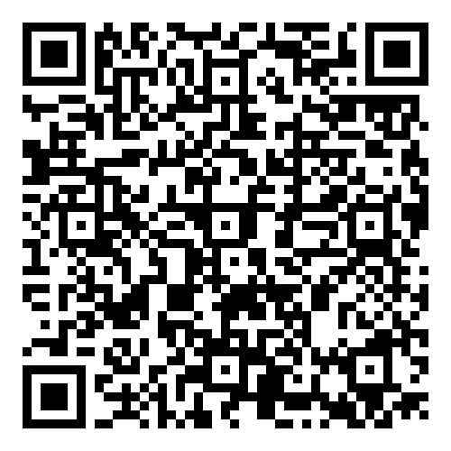
NEXT SESSION
Your track record and the narrative CV (R4RI)
Wednesday 10 July
10 am-1pm.

